Slide 1
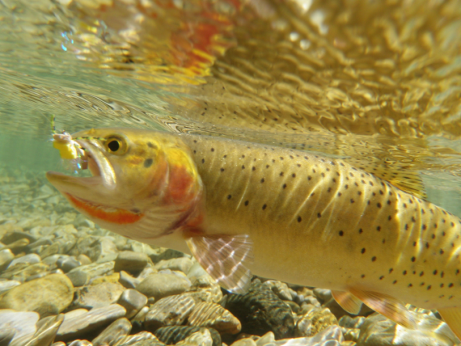



Projecting Effects of Climate Change on River Habitats and Salmonid Fishes:
Integrating Remote Sensing, Genomics, and Demography to Inform Conservation
Brian Hand & Gordon Luikart – April 23rd, 2015
Notes:
1. We want to thank Woody & Cindy Schmidt for bringing us all here and for making our past year very productive.

Slide 2
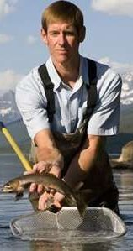
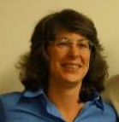
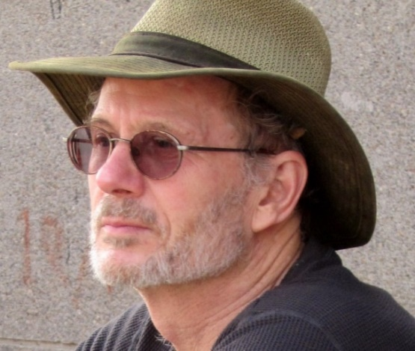
Acknowledgements
  Jen Bayer (USGS)
  Clint Muhlfeld
  (USGS)
Robin Waples (NOAA)
Notes:
Special thanks to Jen Bayer who is our major partner in the future hosting of our software tool and also thanks to Clint M. and Robin W, who are two of many end users from several state and federal agencies.

Slide 3
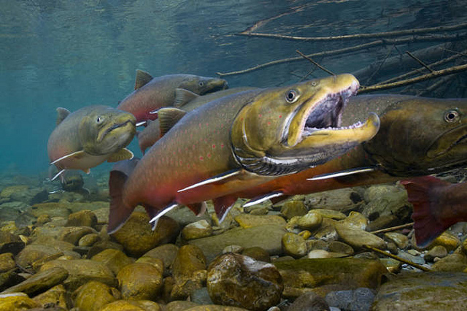
Urgent need for climate change vulnerability assessments (CCVAs), especially for salmonids
Recent presidential task force report calls for federal agencies to conduct CCVAs
Salmonids are “canaries of climate change”.
Spawning bull trout
Least Vulnerable
http://www.arsconsulting.org/id11.html
Vulnerability: the degree to which a system is susceptible to, or unable to cope with, adverse effects of climate change, including climate variability and extremes (IPCC 2001).
Most Vulnerable
Notes:
A recent presidential task force report called for federal agencies to assess climate change vulnerability of spp and habitats. There is also increasing need for DSS tools to help decision makers conduct CCVA and monitor population status because there are few tools available.
Salmonids are ectothermic, providing an excellent opportunity to study the impacts of climate change on several species.
A major goal (and reason) for assessing vulnerability is to allow managers and decision-makers to better monitor and mitigate population extirpation into the future. So you can give them a map and say, we believe these populations might be in more relative trouble and need further monitoring, or we believe these populations are doing relatively well now and into the future.

Slide 4
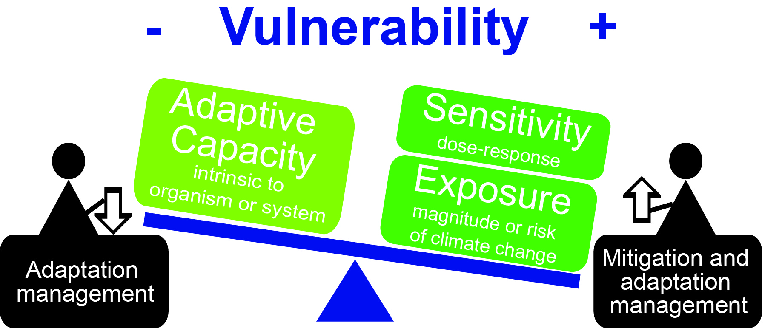
The 3 major components of vulnerability as established by a panel from multiple federal agencies (Glick et al. 2011):
Sensitivity – Physiological response (e.g., high stream temps that results in death or high stress)
Exposure – Magnitude of climate stress (e.g., increase in future stream temp.)
Adaptive Capacity – Ability to adapt (e.g., evolutionary potential)
Wade et al. in prep.

Slide 5
Year 1 Overarching Questions
How can we improve CCVAs and decision support tools for conservation decision-making (Wade et al. in prep)?
Are environmental variables correlated with genetic diversity in steelhead and bull trout (Hand et al. in review; Kovach et al. in press)?
How does use of different data types (environmental, demographic and genetic) change CCVA results (Wade, Hand et al. in prep)?

Slide 6
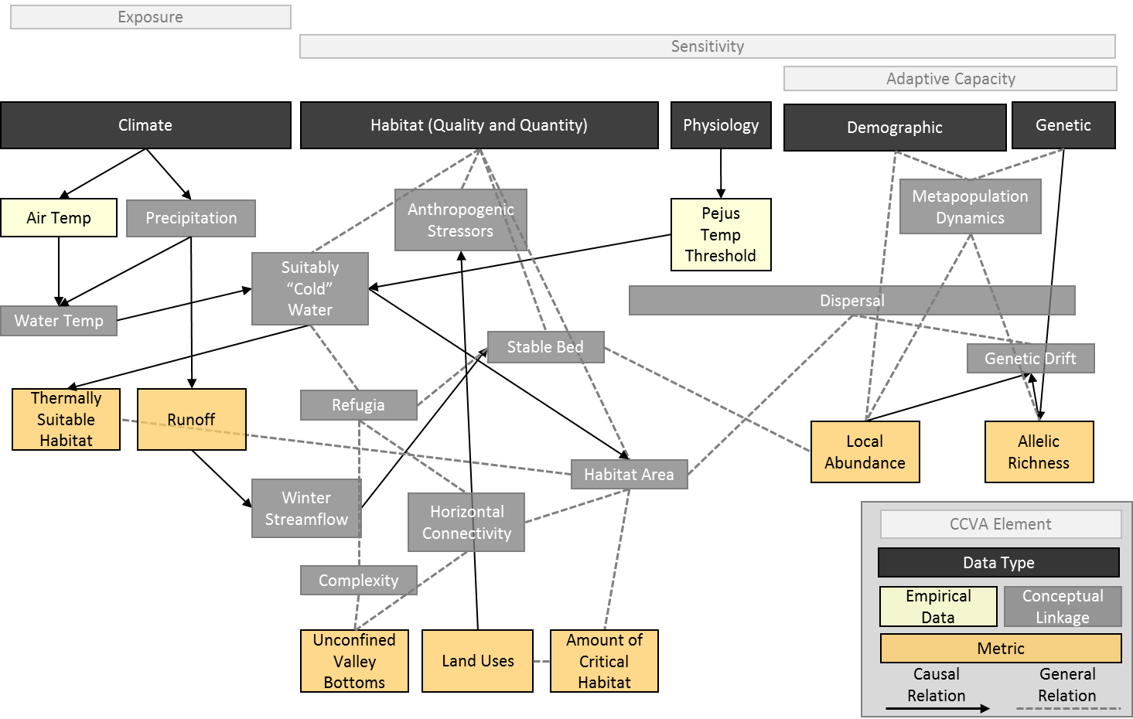
We provided a conceptual framework for conducting climate change vulnerability assessments (CCVAs) to improve scientific rigor (Wade et al. in prep).
a. By integrating remotely-sensed habitat and climate, demographic, and genetics data
b. Improving assessment of model uncertainty and sensitivity.
Climate
Habitat
Demographic
Genetic
Fig here from Glick et al. 2011
Notes:
1. We have focused on integrating many different data types into CCVAs because there is a wealth of data available. Most notably, we have also worked hard to incorporate genetic data into CCVAs because this data type has been lacking previously, but provide one of the greatest gains in our understanding of the impacts of climate change on salmonids and other taxa.
2. Climate and Habitat (Quality and Quantity) are becoming increasingly available thanks to remote sensing!! We have developed many of these remote sensing products into a web-based data base and tool called the Riverscape Analysis Project or RAP.
Paste conceptual model from below in here –
Big arrow to the Climate and Habitat boxes – remote sensing here
Have a slide with climate and habitat metrics at the end

Slide 7
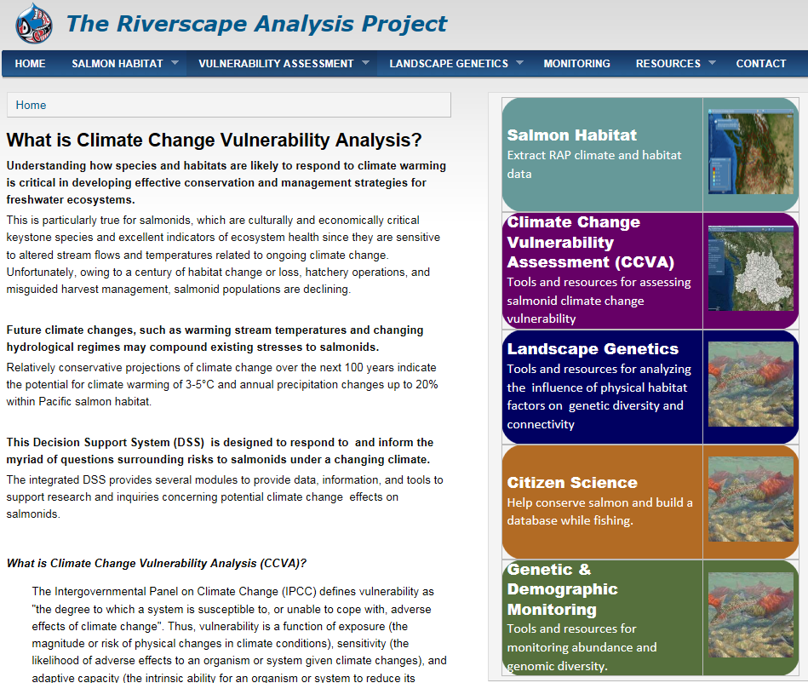
Accessibility: web-based platform for modeling, decision making, & disseminating results.
Notes:
Here’s RAP. As you can see we are working on several tools for the future, and putting them into a user-friendly, web-based platform that includes not only software tools, but case studies, tutorials and educational material to help managers and decision makers learn more about how and why to conduct CCVAs.

Slide 8
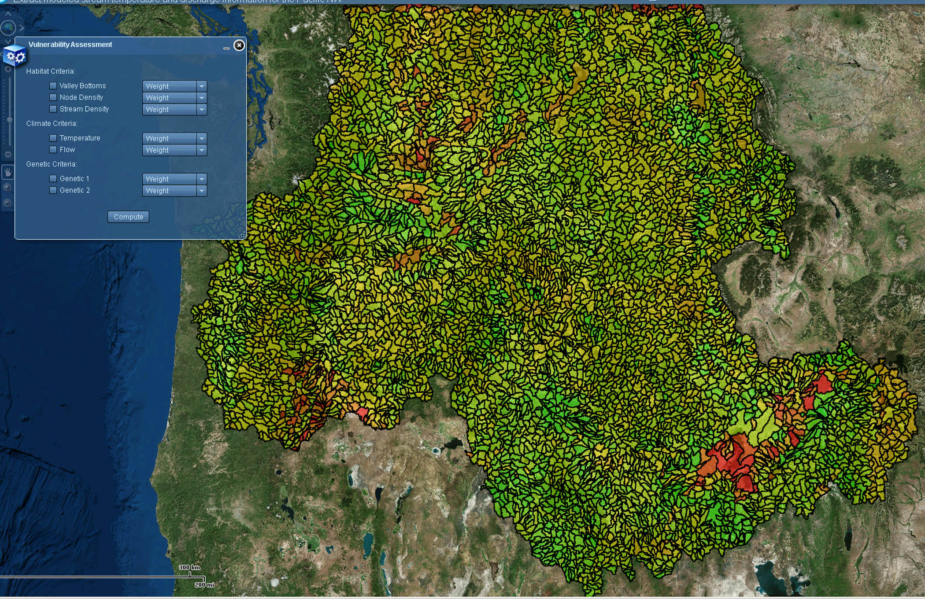
User-Friendly Web Tool for Salmon Vulnerability Assessment
Habitat
Climate
Genetic
Demographic
Users can specify habitat, climate, genetic and demographic data to use in the CCVA
Vulnerable sub-drainages
Notes:
Here is our prototype tool for ranking salmon vulnerability. The box on the left is difficult to read, but the purpose of it is to allow users an easy interface to point and click on the types of data (genetics, demographics, climate or habitat) that they want to include in their analysis, along with several metrics available under each. As I mentioned, RAP is built on an extensive database of habitat and climate metrics, numbering around 50-60 so far and growing. We are now excited to start adding in genetic and demographic data for the future.
Put in text habitat, climate, genetic demographic****

Slide 9
Year 1 Overarching Questions
How can we improve CCVAs and decision support tools for conservation decision-making (Wade et al. in prep)?
Are environmental variables correlated with genetic diversity in steelhead and bull trout (Hand et al. in review; Kovach et al. in press)?
How does use of different data types (environmental, demographic and genetic) change CCVA results (Wade, Hand et al. in prep)?

Slide 10
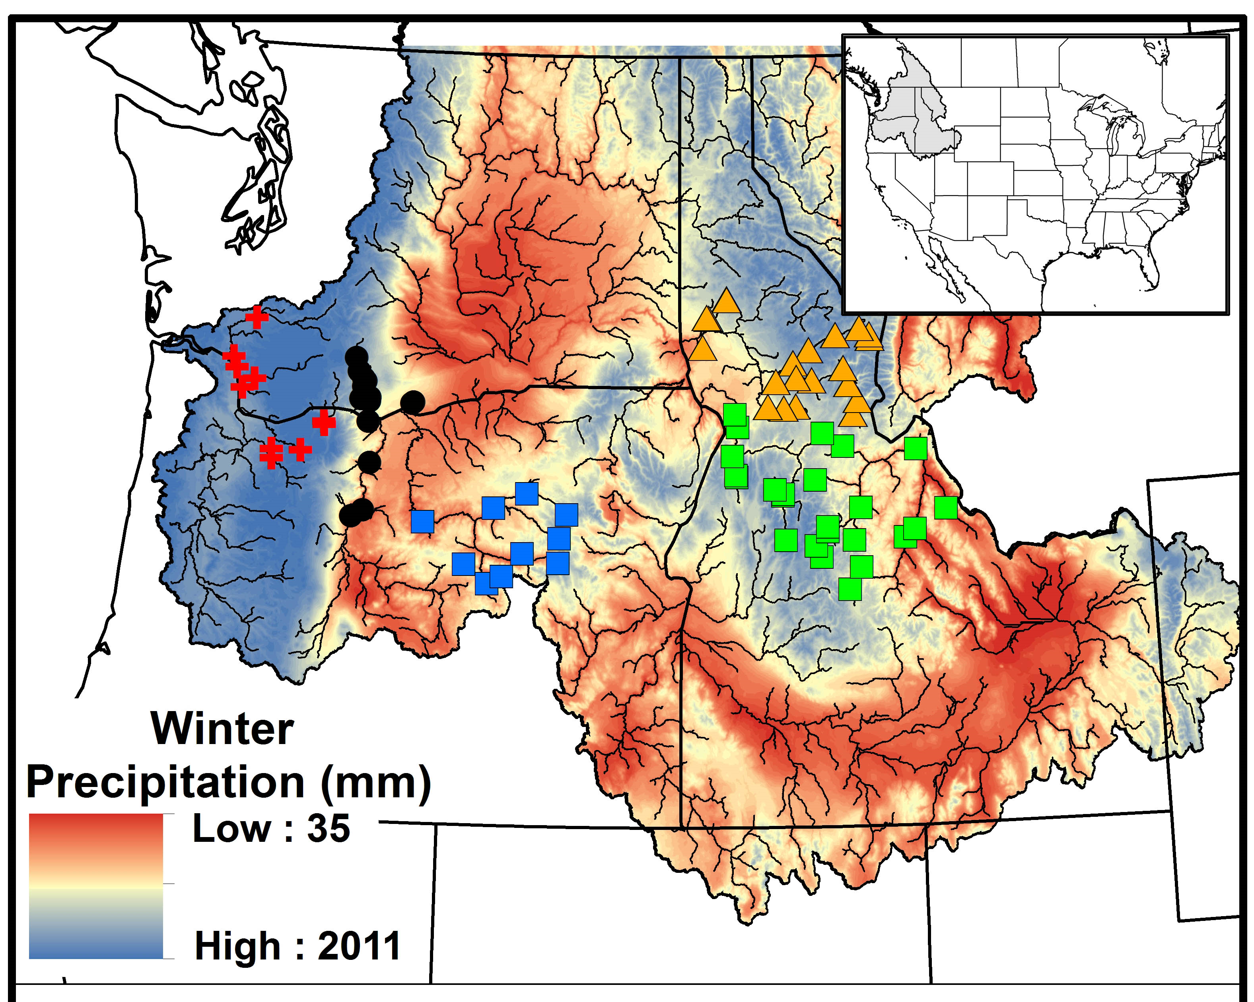
Methods: Many populations (N = 79) in 5 “replicate” study areas with many gene markers (N = 180 SNPs) were modeled.
Steelhead DPSs:
Lower Columbia
Eastern Cascades
John Day
Clearwater
Salmon
1
2
4
3
5
Winter precipitation – Jan - March
Notes:
In Salmonids, we are fortunate to have some of the largest genetic data sets available anywhere, and for any taxa. Here we are looking at steelhead data for 79 populations and several thousands of individuals across the Columbia River Basin. For our first study we grouped these populations into 5 major study areas and within each study area we tried to correlate local climate and habitat metrics to genetic diversity.

Slide 11
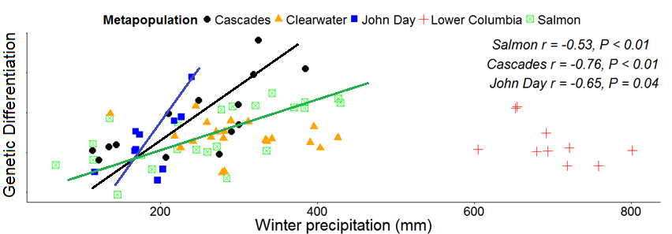
Climate variables (winter precip.) were strongly correlated with steelhead genetic diversity!
0.68
0.75
0.63
Results suggest feasibility for predicting future vulnerability of populations and genetic diversity to climate change.
Notes:
Fitting a simple regression line, we found that winter precipitation was strongly correlated to genetic diversity in 3 of 5 study areas.
Genetic differentiation is genetic diversity between populations.

Slide 12
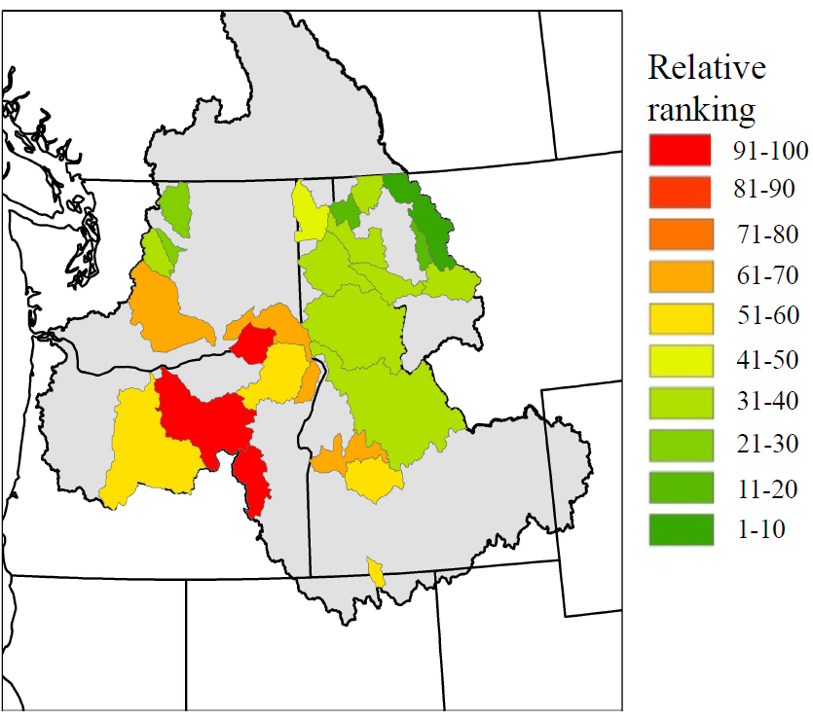
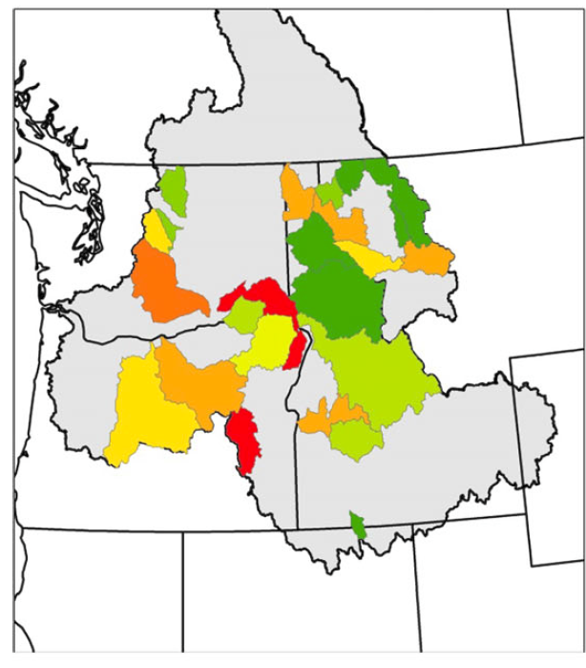
Climate and habitat variables (temperature) were correlated with bull trout genetic diversity in 130 populations in 24 study areas.
Max Summer Temp
Maximum Summer Temperature Genetic Diversity
Kovach et al. 2015
Populations with lower genetic diversity also faced the highest future exposure to warmer stream temperatures, etc. ... and, thus, are more vulnerable.
Notes:
The double whammy
Predicted future vulnerability was negatively correlated with genetic diversity (r = -0.45 – -0.61; P < 0.026);

Slide 13
Year 1 Overarching Questions
How can we improve CCVAs and decision support tools for conservation decision-making (Wade et al. in prep)?
Are environmental variables correlated with genetic diversity in steelhead and bull trout (Hand et al. in review; Kovach et al. in press)?
How does use of different data types (environmental, demographic and genetic) change CCVA results (Wade, Hand et al. in prep)?

Slide 14
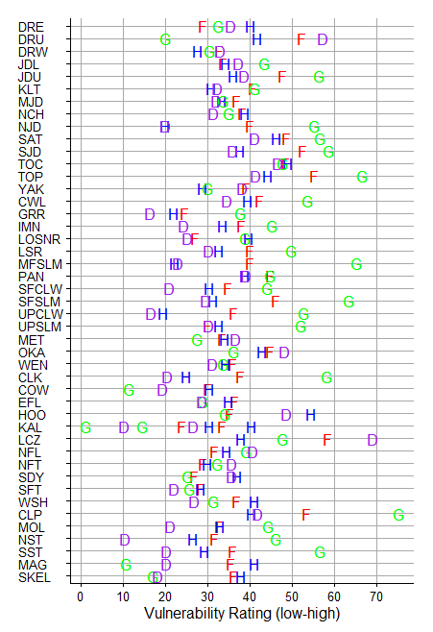
Sensitivity analysis shows CCVA’s using different data types give different results.
Managers and decision-makers should consider several sources of data and conduct sensitivity analysis.
Bull trout vulnerability
Steelhead vulnerability
Wade, Hand, et al. in prep

Slide 15
Year 1 Overarching Questions – Major Outcomes
How can we improve CCVAs?
By providing a standardized framework and web-based tools for conducting CCVAs and accounting for uncertainty and sensitivity (Wade et al. in prep).
Are environmental variables correlated with genetic diversity?
YES! We found strong correlations, among the highest found for any taxa, between climate related factors and genetic diversity in steelhead and bull trout (Kovach et al. 2015; Hand et al. in review).
How does use of different data types impact CCVA results?
Sensitivity analysis shows CCVA’s using different data types give different results which suggests that it is crucial to consider many data types.
Notes:
Genetic data is becoming more widely available and thus should be considered and used in CCVAs.
It is encouraging that we did find strong correlations.

Slide 16
Future & other research
Improved CCVA: additional remote sensing, hatchery, human footprint data types
Develop more sophisticated model testing (e.g., correlating environmental variables to genetic diversity to improve CCVAs).
Testing for temporal correlations between habitat or climate change and changes in genetic diversity.
Demographic & genetic monitoring
  Pilot program using drones to count spawning redds (nests) and/or individuals
Notes:
Say above, it was encouraging that even with simple models we found a strong correlation.

Slide 17

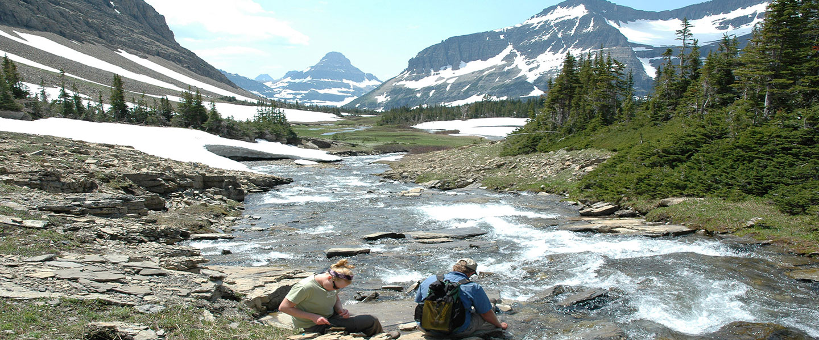
Thanks!

Slide 20
A conceptual model for a pilot CCVA for steelhead and bull trout (Wade, Hand et al. in prep).
Climate
Habitat
Demographic
Genetic
Notes:
We used our understanding from answering the first two questions to conduct a pilot CCVA for steelhead and bull trout. Again, we wanted to answer this question of how does the inclusion of different data types change CCVA results.
Those 4 major categories are highlighted here.

Slide 21
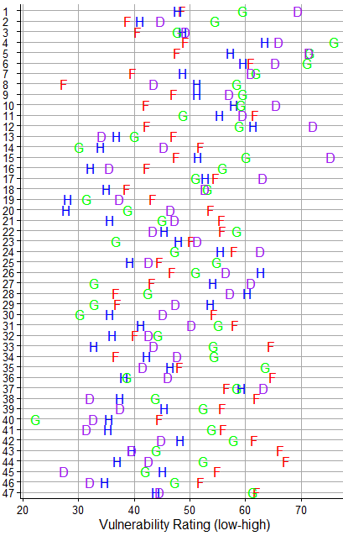
Year 1 Results – Pilot CCVA for steelhead and bull trout

Slide 22
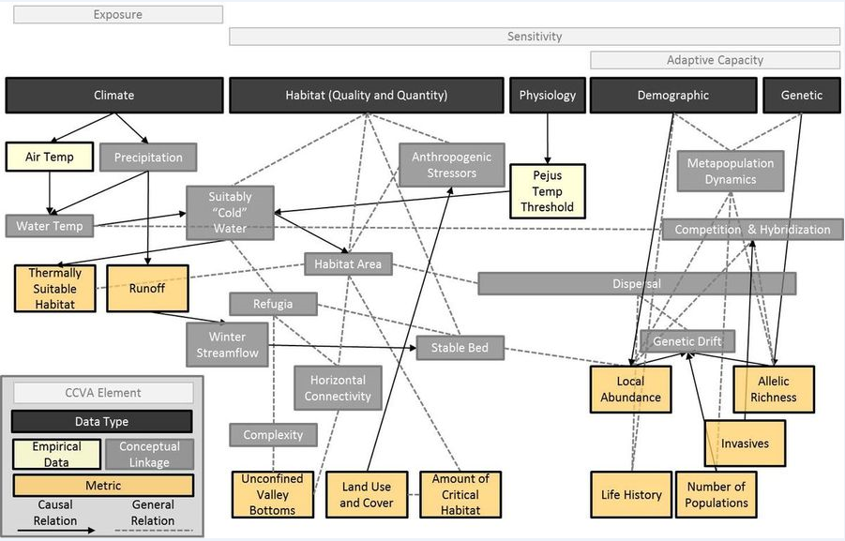
How can we improve CCVAs and decision support for conservation decision-making (Wade et al. in prep)?
1. Improve conceptual understanding and framework for CCVA
Genetic information (i.e., adaptive capacity) is often not incorporated into CCVAs
2. Improve scientific rigor by providing tools to:
a. integrate data on habitat quality, demography, genetics, & climate
b. improve assessment of uncertainty and sensitivity.
Conceptual model of hypothesized stressors to bull trout
Fig here from Glick et al. 2011
NASA products:
Freeze thaw
Fractional water
(inundation)
Net Primary prod.
DAYMET
For salmon:
VSPs lack adaptive capacity and climate change considerations.
RAP facilitates use of AC and CC.
Wade et al. in prep.
Notes:
Two greatest needs to improve CCVAs (1) conceptual understanding and frame work (as in Wade et al. in review)
No clearMuch promise as conservation management tool in the face of considerable uncertainty, the assessment process is often not well-grounded in conservation science
Conceptual model of hypothesized stressors to bull trout
a. integrating data on habitat quality, demography, & genetics to better reflect climatic sensitivity and adaptive capacity.

Slide 23
Year 1 Overarching Questions – Major Outcomes
How can we do to improve CCVAs and decision support for conservation (Wade et al. in prep)?
Provide an improved conceptual framework for CCVA by incorporating genetic data into CCVAs (i.e., accounting for adaptive capacity).
Improve scientific rigor by providing a standardized tool and method for conducting CCVAs.
Are environmental variables correlated with genetic differentiation in steelhead (Hand et al. in review) and genetic diversity in bull trout (Kovach et al. in press)?
YES! There was a strong correlation between climate related factors and genetic differentiation in steelhead and genetic diversity in bulltrout.
How do different sources of input (environmental, demographic and genetic) impact CCVA results, and thus, management decisions that may rely on only one or two data sources?

Slide 24


Summary Conclusions
1. Our interdisciplinary group includes experts (remote sensing, genomics, fish ecology, modeling, GIS/DSS) and end-user agencies (federal, state, NGOs) making it feasible to vastly improve conservation decision making, by using RAP tools.
2. Our prototype web-based RAP-DSS is valuable because it integrates remotely-sensed habitat & climate data with genetic and demographic datasets (filling a crucial need).
3. Partners from six agencies & two NGOs are committed, as demonstrated by their funding match & housing

Slide 25
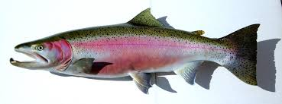
The greatest challenges:
CCVAs lack conceptual understanding & framework, lack scientific rigor, and often neglect the adaptive capacity component.
To overcome these challenges:
To increase scientific rigor, we developed guidelines and tools (e.g. for uncertainty analysis).
Conceptual model of steelhead risk factors
steelhead
Notes:
2:00 (3.5 total at end)
Two of our challenges to conducting CCVAs were that the approach lackes conceptual understanding and a framework to actually plan & conduct a CCVA, AND there is also a lack of scientific rigor. For example, there is no well-established or accepted framework or “best practices” for integrating different kinds of information and risks (like genetic and demographic metrics). Also there are no guidelines or “best practices” for quantifying uncertainty in the assessment that a given population is the most vulnerable.
To help overcome these challenges, we held a workshop, phone conferences, had visits with end-users (e.g., NOAA, IDF&G, USGS and USFWS), we produced FOUR educational web pages and publications to help advance conceptual understanding and “best practices” of how to conduct a CCVA.
THIS chart shows an example conceptual model or framework of many risk factors influencing vulnerability of Steelhead pops (it’s Fig 1 in our report). This kind of conceptual modeling really helped us and our collaborators understand and develop CCVAs.
To help increase scientific rigor, we developed general guidelines and tools for assessing uncertainty, and produced 9 publications co-authored with end-users.
I’ll next show you briefly RAP web pages and an example web tool.
For ARCGIS type systems few web-based interfaces exist… very NOVEL to have all the tools together… Mention ‘baseline’ was zero/few CCVA
2. Impossible to test for positive conservation outcome (e.g. increased abundance) from CCVAs in only 1-4 years
To over come:
We work with end users to develop the most needed tools
for CCVA, landscape genetics, demo-genetic monitoring to
help improve conservation decision making.

